Slide 1
Eclipse Plug-in Development
SWT/JFace Development Part 3
Layouts

Slide 2
Contents
Introducing the Layout
Layout in SWT
RowLayout
FillLayout
GridLayout
FormLayout
StackLayout
Define your Layout

Slide 3
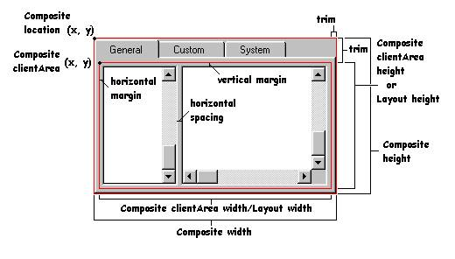
Layout
Layout
clientArea
margin
spacing
LayoutData
width
height
exclude

Slide 4
RowLayout
Type
SWT.HORIZONTAL
SWT.VERTICAL
Margins
width and height
top, left, right and bottom
Wrap
Fill
Center
Pack
Justify
Spacing
RowLayout rowLayout = new RowLayout();
rowLayout.wrap = false;
rowLayout.pack = false;
rowLayout.justify = true;
rowLayout.type = SWT.VERTICAL;
rowLayout.marginLeft = 5;
rowLayout.marginTop = 5;
rowLayout.marginRight = 5;
rowLayout.marginBottom = 5;
rowLayout.spacing = 0;

Slide 5
RowLayout
RowData
width
height
exclude
RowData rowData = new RowData();
rowData.height = 50;
rowData.width = 50;
rowData.exclude = false;

Slide 6
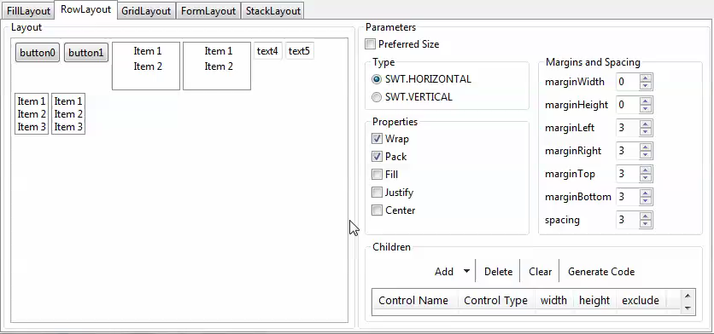
RowLayout

Slide 7
FillLayout
Type
SWT.HORIZONTAL
SWT.VERTICAL
Margin
width
height
Spacing
FillLayout fillLayout = new FillLayout();
fillLayout.type = SWT.VERTICAL;
fillLayout.marginHeight = 5;
fillLayout.marginWidth = 5;
fillLayout.spacing = 1;

Slide 8
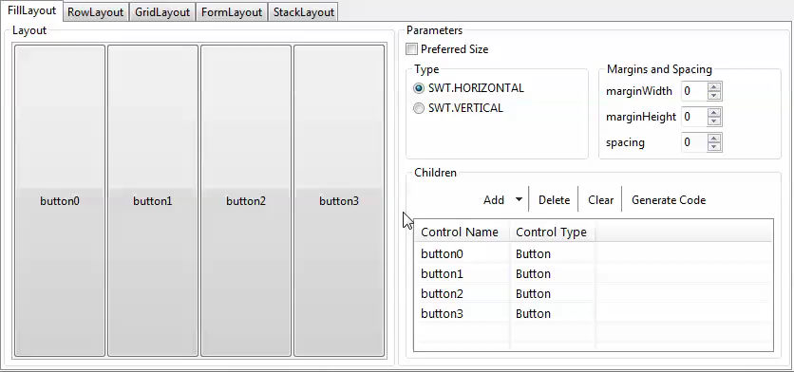
FillLayout

Slide 9
GridLayout
Columns
numColumns
makeColumnsEqualsWidth
Margins
width and height
top, left, right and bottom
Spacings
horizontal
vertical
GridLayout layout = new GridLayout();
layout.numColumns = 2;
layout.makeColumnsEqualWidth= true;
layout.marginHeight = 5;
layout.marginWidth = 5;
layout.horizontalSpacing = 0;
layout.verticalSpacing = 0;

Slide 10
GridLayout
GridData
Alignment
Indentation
Grab extra space
Span
Minimum size
Exclude
GridData data = new GridData();
data.grabExcessHorizontalSpace = true; // grab extra horizontal space
data.horizontalAlignment = GridData.FILL; // BEGINNING, CENTER, END and FILL
data.horizontalSpan = 2; // 2 columns
data.horizontalIndent = 1; // from left side 1 pixels

Slide 11
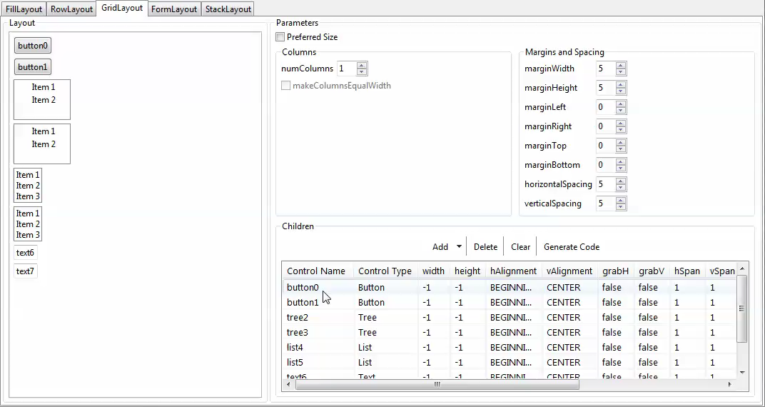
GridLayout

Slide 12
FormLayout
FormLayout
Margins
width and height
top, bottom, left and right
Spacing
FormLayout layout = new FormLayout();
layout.marginWidth = 3;
layout.marginHeight = 3;

Slide 13
FormLayout
FormData
Preferred Size
width
height
Attachments
left
right
top
bottom
FormData data1 = new FormData();
data1.left = new FormAttachment(0, 0);
data1.top = new FormAttachment(0, 0);
button1.setLayoutData(data1);
FormData data2 = new FormData();
data2.left = new FormAttachment(button1);
data2.top = new FormAttachment(0, 0);
data2.right = new FormAttachment(100, 0);
button2.setLayoutData(data2);

Slide 14
FormLayout
FormAttachment
Mathematical Fraction
numerator
denominator (!= 0, default 100)
offset
Based on other Control
control
offset
alignment
TOP, BOTTOM, LEFT, RIGHT, CENTER, DEFAULT
new FormAttachment(numerator);
new FormAttachment(numerator, offset);
new FormAttachment(numerator, denominator, offset);
new FormAttachment(control);
new FormAttachment(control, offset);
new FormAttachment(control, offset, alignment);

Slide 15
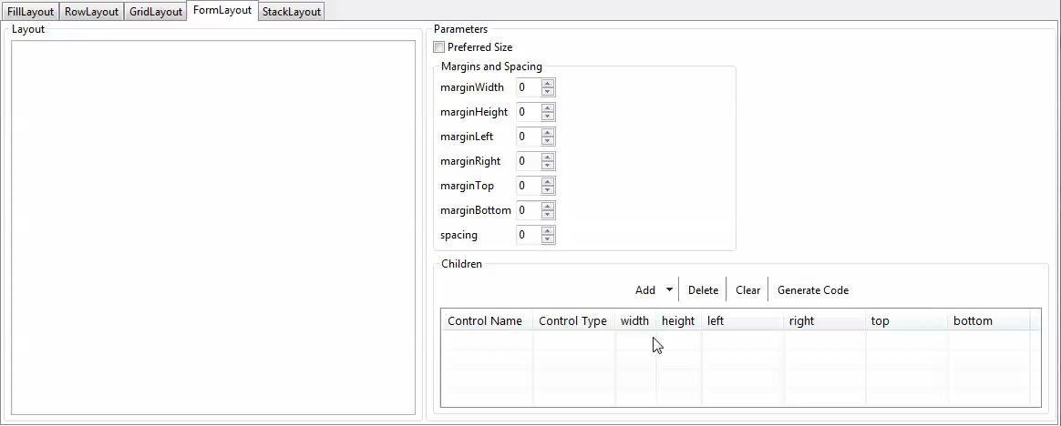
FromLayout

Slide 16
StackLayout
Same size and location
Top control
Margins
width and height
StackLayout layout = new StackLayout();
layout.marginHeight = 5;
layout.marginWidth = 5;
layout.topControl = someone;

Slide 17
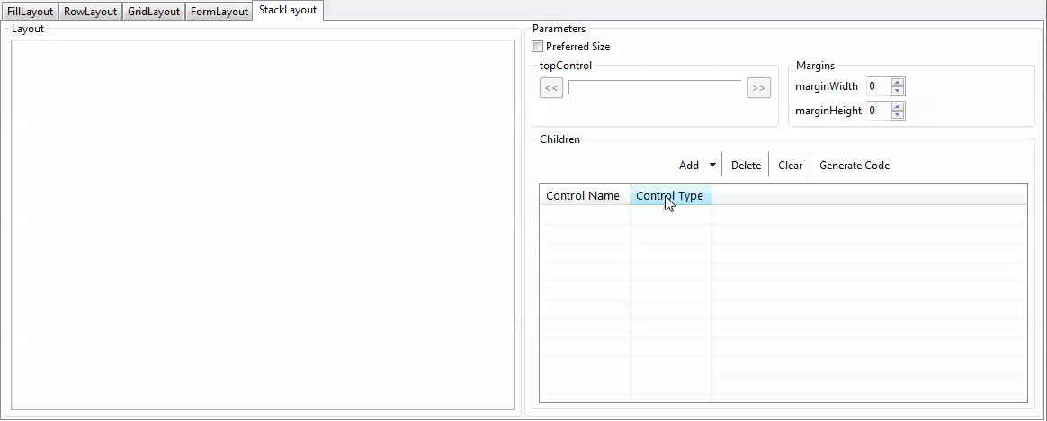
StackLayout

Slide 18
Custom Layout
Implementing Layout class
Point computeSize (composite, wHint, hHint, flushCache)
layout (composite, flushCache)
Advanced with LayoutData
public class MyLayout extends Layout {
protected Point computeSize(Composite composite, int wHint, int hHint, boolean flushCache) {
return null;
}
protected void layout(Composite composite, boolean flushCache){
// your layout algorithm.
}
}
algorithm

Slide 19
Layout for Table Columns
TableLayout
ColumnLayoutData
ColumnPixelData
width
resizable
addTrim
ColumnWeightData
weight
minimumWidth
resizable
TableColumnLayout

Slide 20
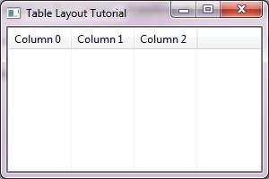
Layout for Table Columns
TableLayout with ColumnPixelData
Table table = new Table(shell, SWT.BORDER);
table.setHeaderVisible(true);
TableLayout layout = new TableLayout();
table.setLayout(layout);
for (int i = 0; i < 3; i++) {
TableColumn column = new TableColumn(table, SWT.NONE);
column.setText("Column " + i);
layout.addColumnData(new ColumnPixelData(70));
}

Slide 21
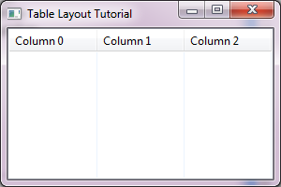
Layout for Table Columns
TableLayout with ColumnPixelData
Table table = new Table(shell, SWT.BORDER);
table.setHeaderVisible(true);
TableLayout layout = new TableLayout();
table.setLayout(layout);
for (int i = 0; i < 3; i++) {
TableColumn column = new TableColumn(table, SWT.NONE);
column.setText("Column " + i);
layout.addColumnData(new ColumnWeightData(1));
}

Slide 22
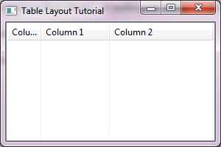
Layout for Table Columns
TableColumnLayout
Shell shell = new Shell(display);
TableColumnLayout layout = new TableColumnLayout();
shell.setLayout(layout);
Table table = new Table(shell, SWT.BORDER);
table.setHeaderVisible(true);
for (int i = 0; i < 3; i++) {
TableColumn column = new TableColumn(table, SWT.NONE);
column.setText("Column " + i);
layout.setColumnData(column, new ColumnWeightData(i + 1));
}

Slide 23
Layout for Tree Columns
TreeColumnLayout
You can only add the Layout to a container whose only child is the Tree control you want the Layout applied to.
Don't assign the layout directly the Tree

Slide 24
Any Questions?
Skype: jin.liu.soyatec
Email: jin.liu@soyatec.com

Slide 25
The end

